Slide 1
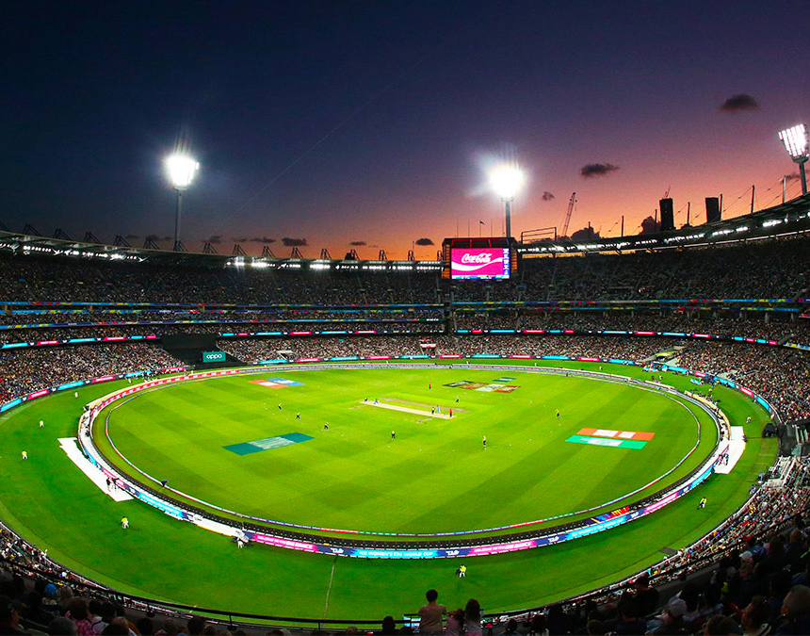
T-20 World Cup Analysis
Presented By-
Soumili Das
Month 2024

Slide 2

AGENDA
The main agenda of this project is to explore cricket data comprehensively. Projects include data cleaning, data exploration, player analysis, performance evaluation, and statistical insights.

Slide 3
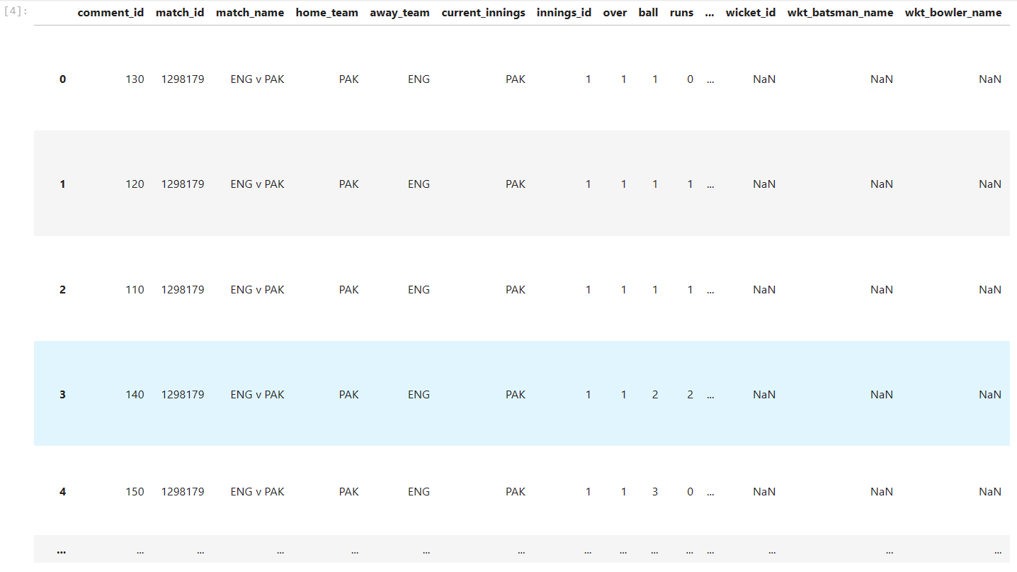
Importing the dataset
The dataset Contains 9814 rows and 44 columns with different information regarding the match where there is
Match_id
Match_name
Home_team
Away_team
Over
Ball
Runs
Batsman name
Bowler name
Run made by each batsman
Over of each Bowler
Commentaries

Slide 4
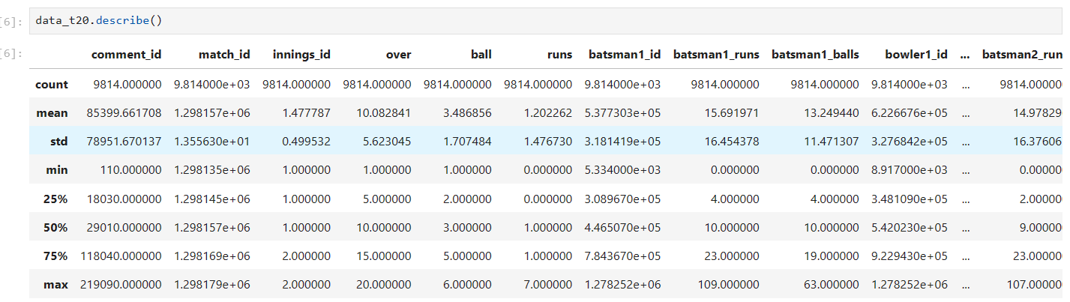
Data Exploration
By using info() function we get the different types of data used in the data set.
By using describe() function we get the count value, minimum, maximum, standard, first Quartile , second quartile and third quartile values.

Slide 5

Data Cleaning
Now, we will try to reduce the data by removing certain unwanted data, null data, or duplication values so that it is ready for further operation. We have dropped some columns such as ‘isNoBall’, ’is Retired Hurt’ ,’is Boundary’, ’is Wide’, ’bowler1_maidens’, ’bowler2_maidens’.

Slide 6
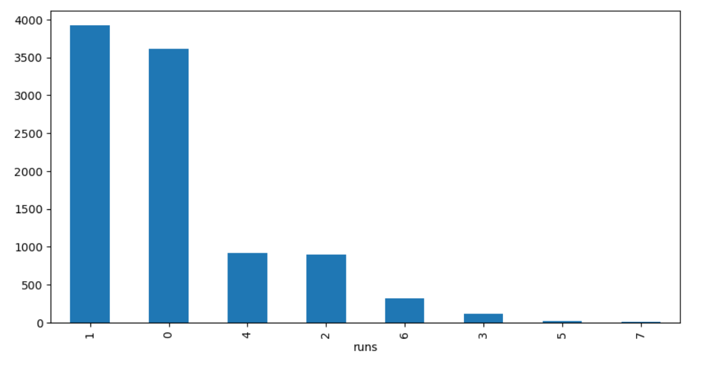
Event Analysis
We have obtain different data’s of match such as no of runs, ball, over, runs made by batsman 1, batsman 2, bowler 1, bowler 2 and then plotted them to get the insights.
No of 3’s and 6’s runs made by individual team is very low .

Slide 7
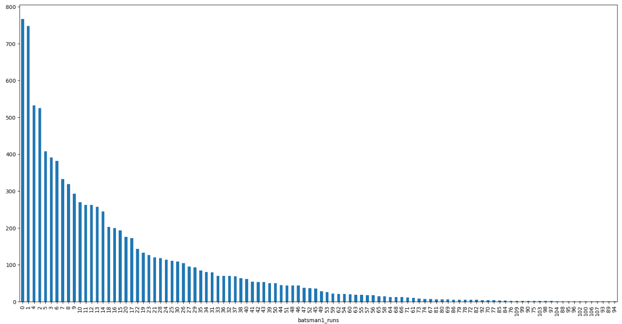
Run made by batsman_1 has a decreasing graph .

Slide 8
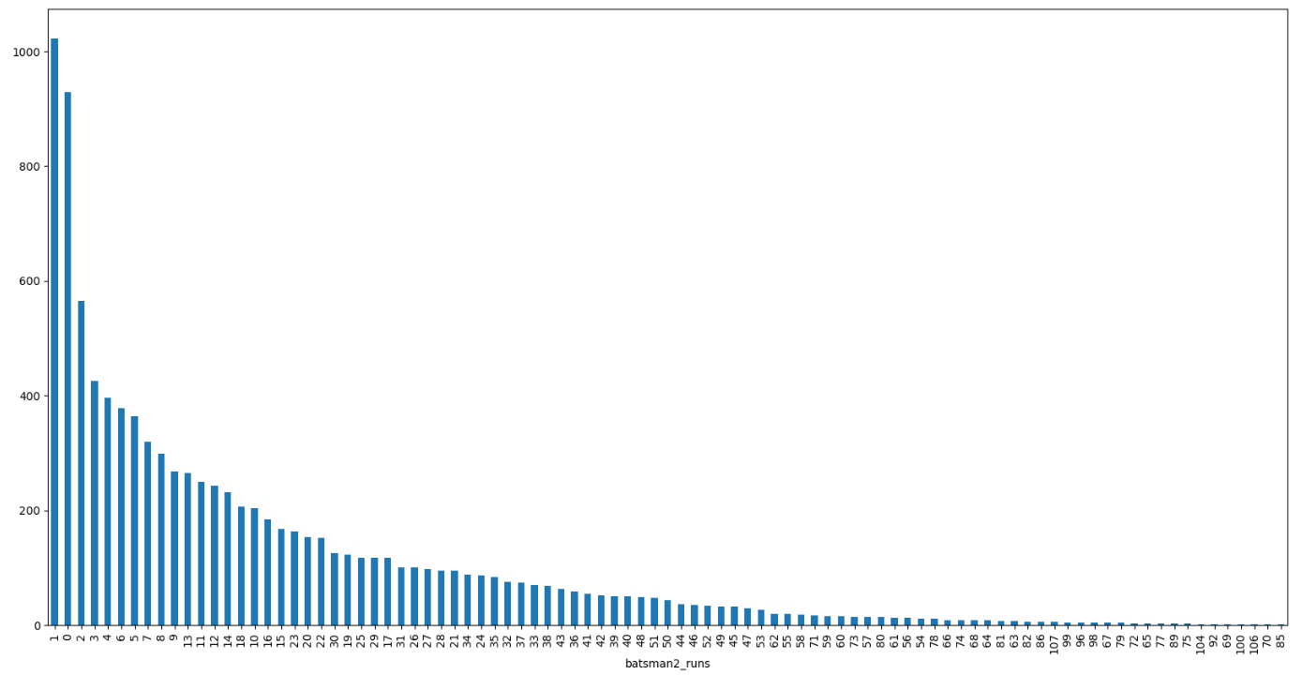
Run made by batsman_2 has a sudden increase with the value of 1 and then starts decreasing with the value of 2.

Slide 9
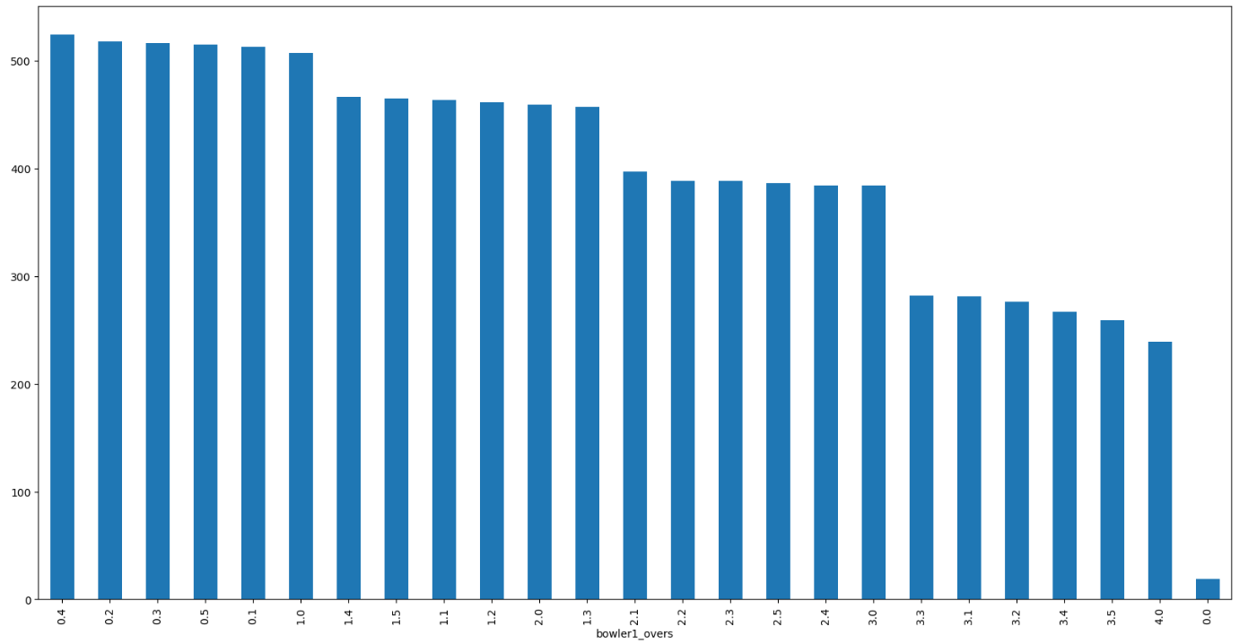
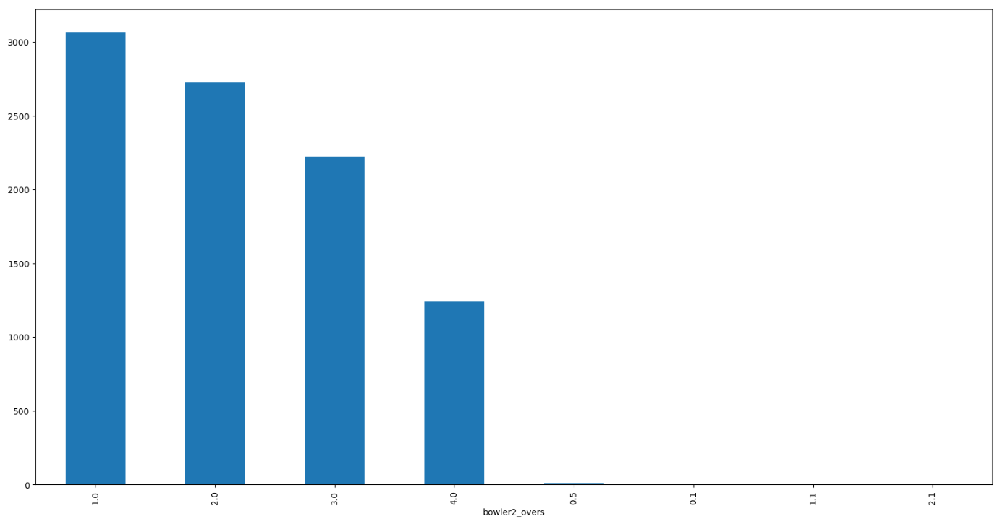
Comparing the overs of bowler1 and bowler2.
The value of overs for bowler1 goes to a high value between 0.4 and 1.4 and then becomes constant upto 2.5.
The value of overs for bowler 2 goes to a very high value 3000 for 1 over and gradually decreases .

Slide 10
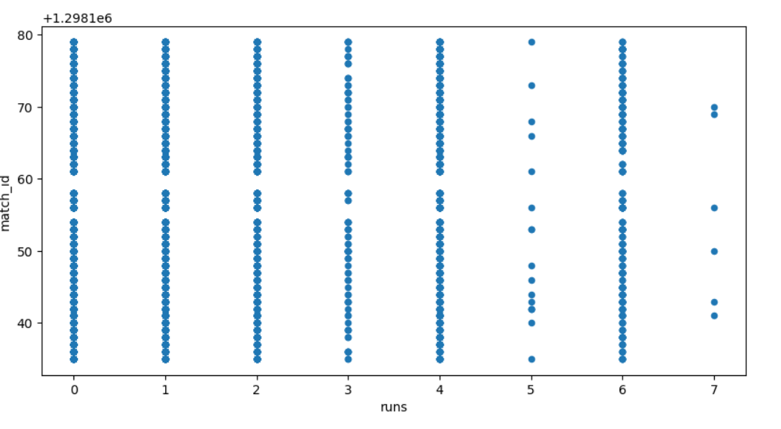
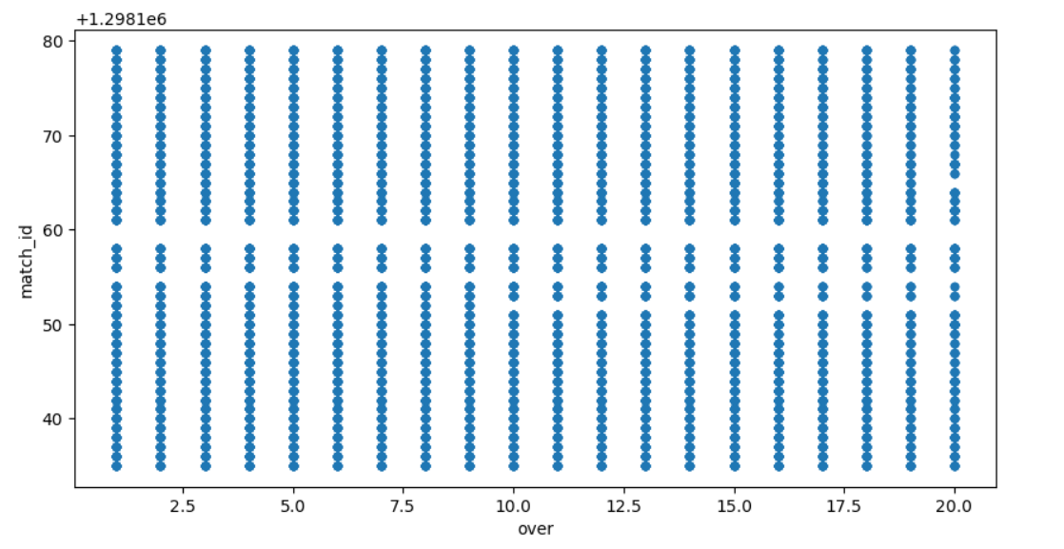
Match Insights
Here, we obtain individual match insights by exploratory data analysis . Here we also analyse performance of individual batsman and bowlers and also the wicket batsman .

Slide 11
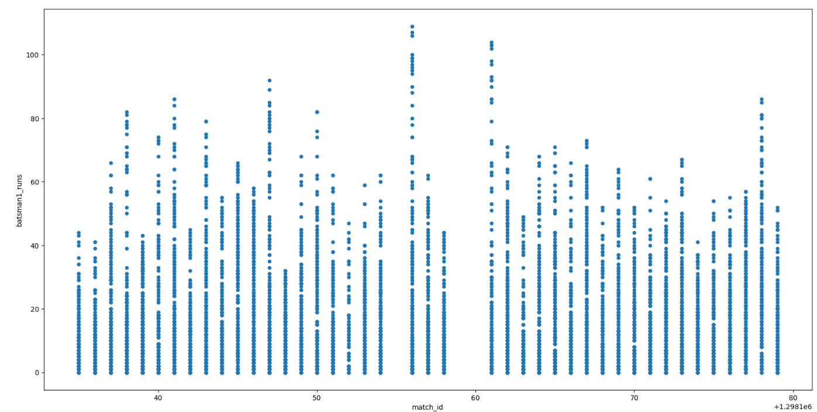
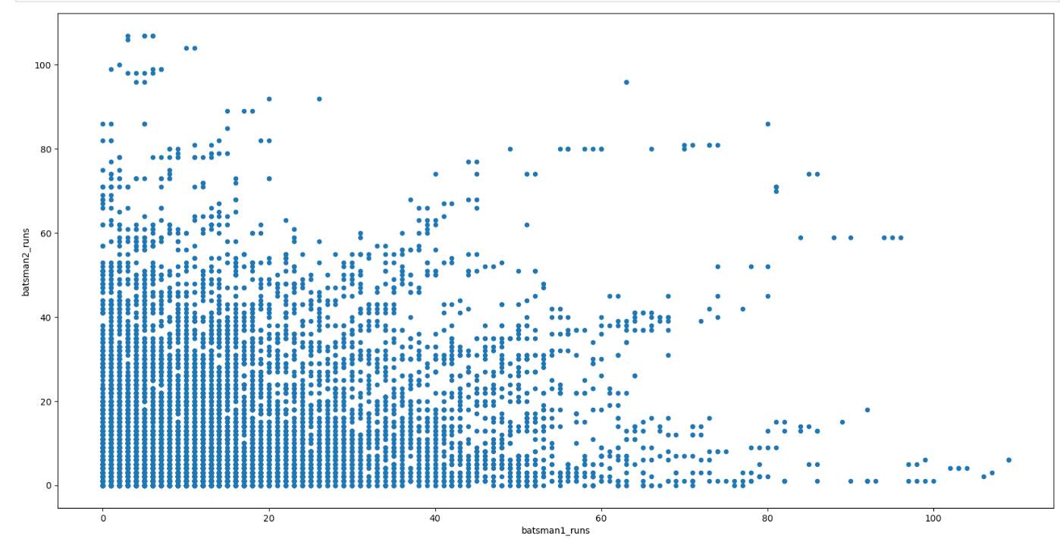
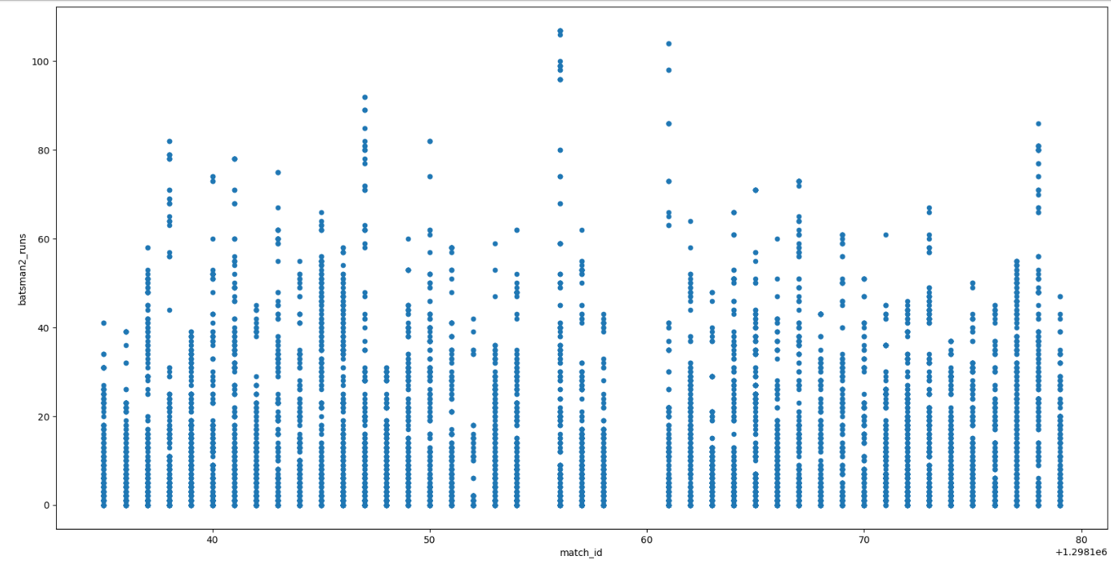

Slide 12
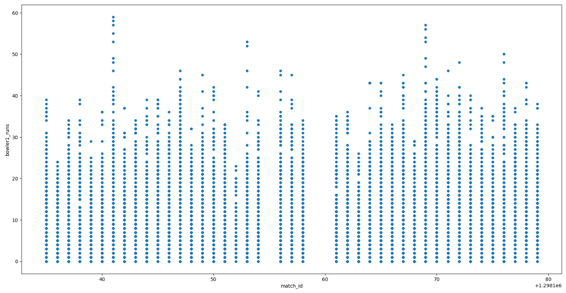
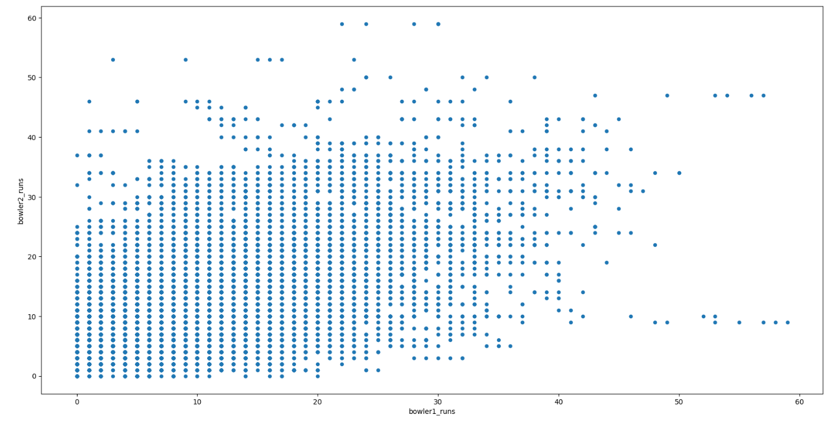
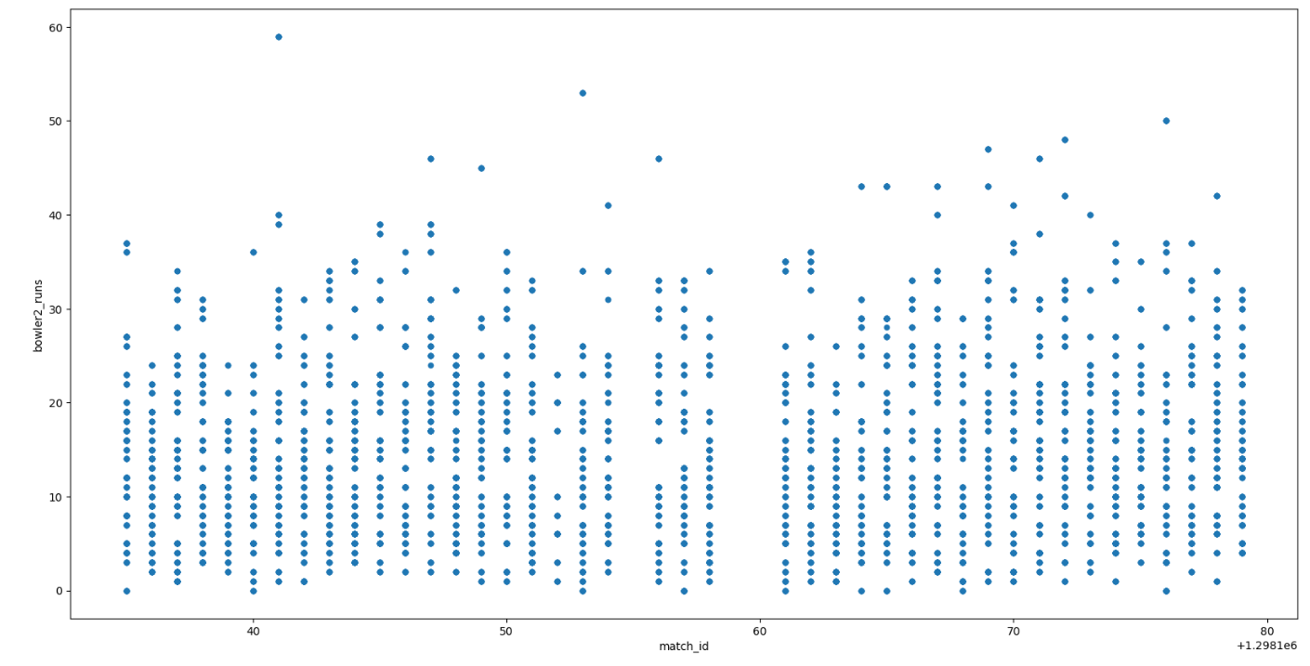

Slide 13
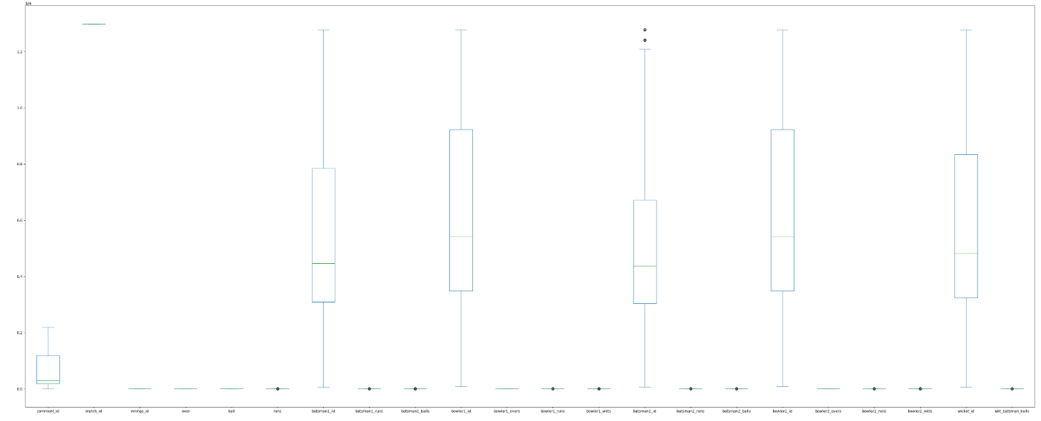
Event Interference
Batsman with maximum Number of 4’s also have most runs(Batsman2).
Bowler with most wickets(bowler1) also has the most maidens.
x
The batsman with most sixes(25) is not in the top 5 players by runs scored.
The wicket batsman did more runs than batsman2.

Slide 14
THANK YOU!

